Slide 1
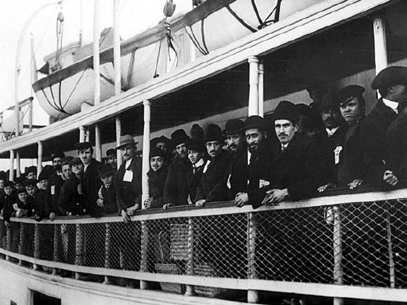
Immigration
1865-1915

Slide 2
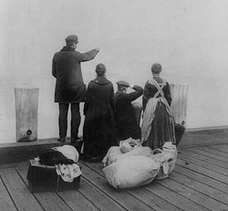
I. Coming to America
In the five decades after the Civil War, a flood of immigrants came to America.
13.5 million immigrants arrived in America during this period – the largest voluntary migration in human history!

Slide 3
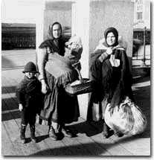
Why did they come?
Wars, famine, religious persecution, and overpopulation were the four major reasons why people left Europe and came to the United States.

Slide 4
II. How did they get here?
Passage to the United States often cost a life’s savings.
Because of this cost, entire families would often save enough money to send just one or two family members to America, hoping that eventually these members could afford to bring over the rest of the family.

Slide 5
Travel Dangers
An agent for the United States Immigration Commission described conditions below deck on one of the migrant ships as follows:
“During the twelve days in the steerage I lived in…surroundings that offended every sense. Only a fresh breeze from the sea overcame the sickening odors. Everything was dirty, sticky, and disagreeable to the touch.”
In such conditions, disease and even death were not uncommon.

Slide 6
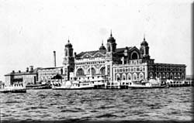
Major Immigration Centers:
1. In 1890, Congress designated low-laying, three-acre Ellis Island in Upper New York Bay as an immigration station.
By the end of 1910, six million immigrants had come through this station.
Arrival at Ellis Island History Channel 3:53

Slide 7
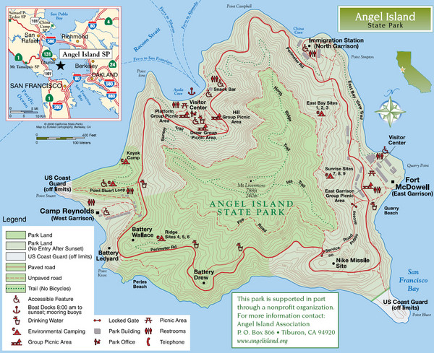
2. Angel Island
Located in San Francisco Bay
From 1910 to 1940, the island processed hundreds of thousands of immigrants, the majority from China.
Notes:
From 1910 to 1940, the island processed hundreds of thousands of immigrants, the majority from China. During World War II, Japanese, and German POWs were held on the island, which was also used as a jumping-off point for American soldiers returning from the Pacific.

Slide 8
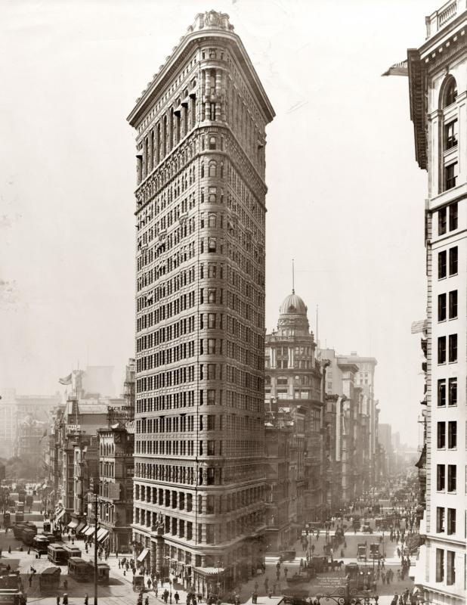
Immigration
Ethnic diversity grew due to the influx of immigrants from Asia and southern and eastern Europe.
Between 1890-1910, the “new” immigrants were primarily from Italy, Austria-Hungary, and Russia.

Slide 9
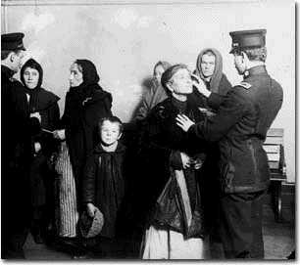
IV. Inspection
The immigration inspection process was a humiliating and dehumanizing experience for many.
Newly arrived immigrants were given medical inspections and asked 32 background questions.
Immigrants with contagious diseases were shipped back.

Slide 10
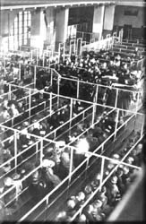
Waiting
Long lines of immigrants were tagged according to what language they spoke
They were also marked with chalk according to the medical ailments they were suspected of having
They waited for the inspectors to decide their fate

Slide 11
Warmup - Quick Review – use your notes to answer the following questions on your own paper
1. From 1865-1900, roughly how many immigrants flooded into the US?
2. What were the four main reasons they left their countries?
3. What are the names of the two main immigration centers that were created in the US to process these immigrants, and where were they located?
Describe the terms of the Chinese Exclusion Act.
Be sure your name, today’s date, and the class period are at the top of your paper – please turn in to the tray when you are finished. Have your notes out – we will finish them today.

Slide 12
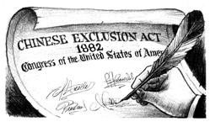
V. Restrictions on Immigration Begin
The Chinese Exclusion Act of 1882 was one of the most significant restrictions on free immigration in US history.
It was the nation's first law to ban immigration by race or nationality.
Notes:
The first significant Chinese immigration to the United States began with the California Gold Rush of 1848-1855, and continued with subsequent large labor projects, such as the building of the First Transcontinental Railroad. During the early stages of the gold rush, when surface gold was plentiful, the Chinese were tolerated, if not well-received. As gold became harder to find and competition increased, animosity toward the Chinese and other foreigners increased. After being forcibly driven from the mines, most Chinese settled in enclaves in cities, mainly San Francisco, and took up low end wage labor such as restaurant work and laundry. With the post Civil War economy in decline by the 1870s, anti-Chinese animosity became politicized by labor leader Denis Kearney and his Workingman's Party as well as by California Governor John Bigler, both of whom blamed Chinese "coolies" for depressed wage levels.
Handbill for public rally – “Hip! Hurrah! The White Man is on Top!”
For all practical purposes, the Exclusion Act, along with the restrictions that followed it, froze the Chinese community in place in 1882, and prevented it from growing and assimilating into U.S. society as European immigrant groups did
The Chinese Exclusion Act gave rise to the first great wave of commercial human smuggling, an activity that later spread to include other national and ethnic groups.
From 1882 until 1943, most Chinese immigrants were barred from entering the United States. The Chinese Exclusion Act was the nation's first law to ban immigration by race or nationality. All Chinese people--except travelers, merchants, teachers, students, and those born in the United States--were barred from entering the country. Federal law prohibited Chinese residents, no matter how long they had legally worked in the United States, from becoming naturalized citizens.
From 1850 to 1865, political and religious rebellions within China left 30 million dead and the country's economy in a state of collapse. Meanwhile, the canning, timber, mining, and railroad industries on the United States's West Coast needed workers. Chinese business owners also wanted immigrants to staff their laundries, restaurants, and small factories.
Smugglers transported people from southern China to Hong Kong, where they were transferred onto passenger steamers bound for Victoria, British Columbia. From Victoria, many immigrants crossed into the United States in small boats at night. Others crossed by land.

Slide 13
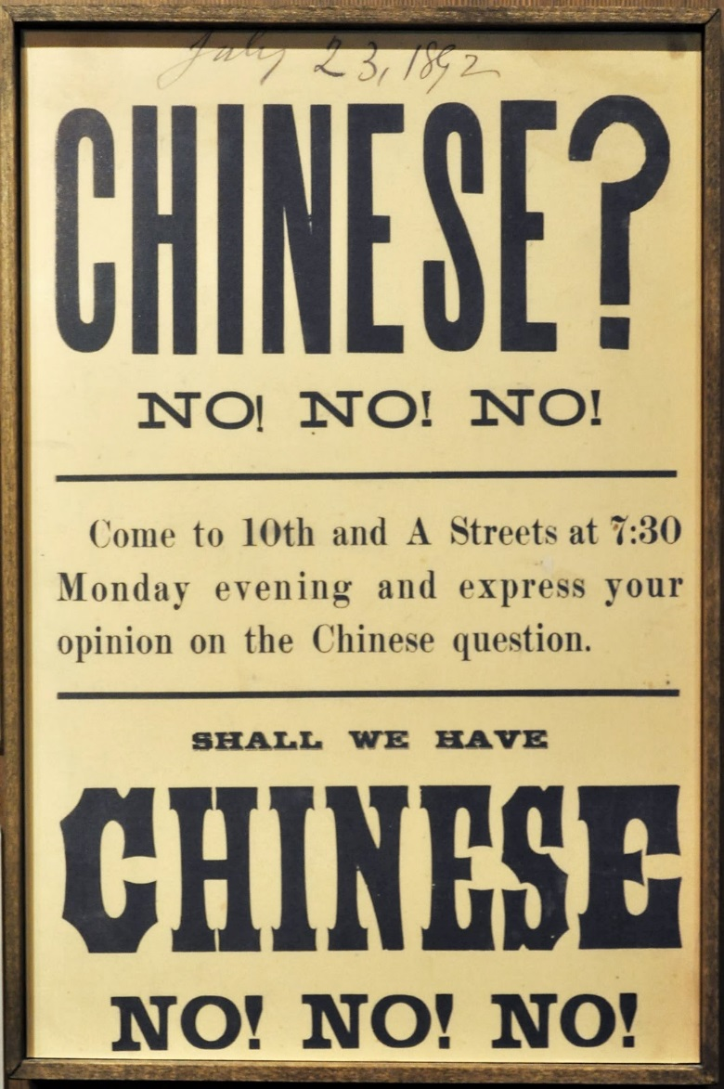
All Chinese people--except travelers, merchants, teachers, students, and those born in the United States--were barred from entering the country.
Chinese residents, no matter how long they had legally worked in the United States, were prohibited from becoming naturalized citizens.

Slide 14
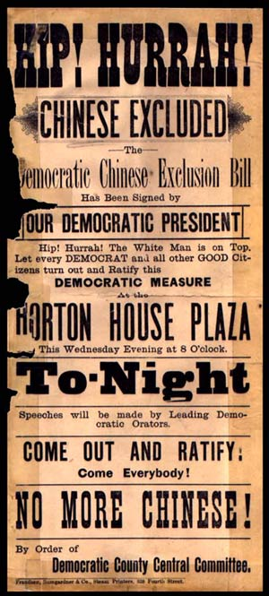
Why???

Slide 15
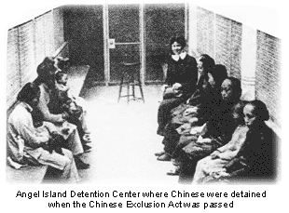
Because they…
took jobs from other Americans, and
were viewed as inferior

Slide 16
Warmup – please complete promptly.
Read the handout (you may write on it if you want) and answer on your own paper:
Who is the author of this letter? His nationality?
What is the purpose of the letter?
Summarize 4 of the arguments the author makes in the letter.
Be sure your name, today’s date, and the class period are at the top of your paper – please turn in to the tray when you are finished. Have your notes out – we will finish them today.

Slide 17
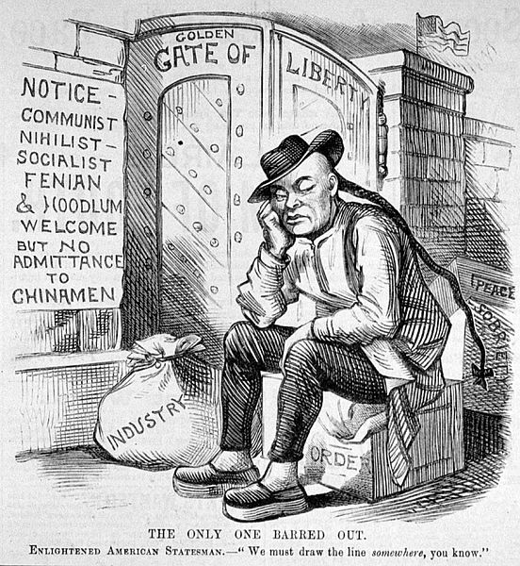
Notes:
The Chinese Exclusion Act did not address the problems that whites were facing; in fact, the Chinese were quickly and eagerly replaced by the Japanese, who assumed the role of the Chinese in society. Unlike the Chinese, some Japanese were even able to climb the rungs of society by setting up businesses or becoming truck farmers. However, the Japanese were later targeted in the National Origins Act of 1924, which banned immigration from east Asia entirely.
The Chinese Exclusion Act was repealed by the 1943 Magnuson Act, which permitted Chinese nationals already residing in the country to become naturalized citizens. It also allowed a national quota of 105 Chinese immigrants per year, although large scale Chinese immigration did not occur until the passage of the Immigration Act of 1965. Despite the fact that the exclusion act was repealed in 1943, the law in California that Chinese people were not allowed to marry whites was not repealed until 1948

Slide 18
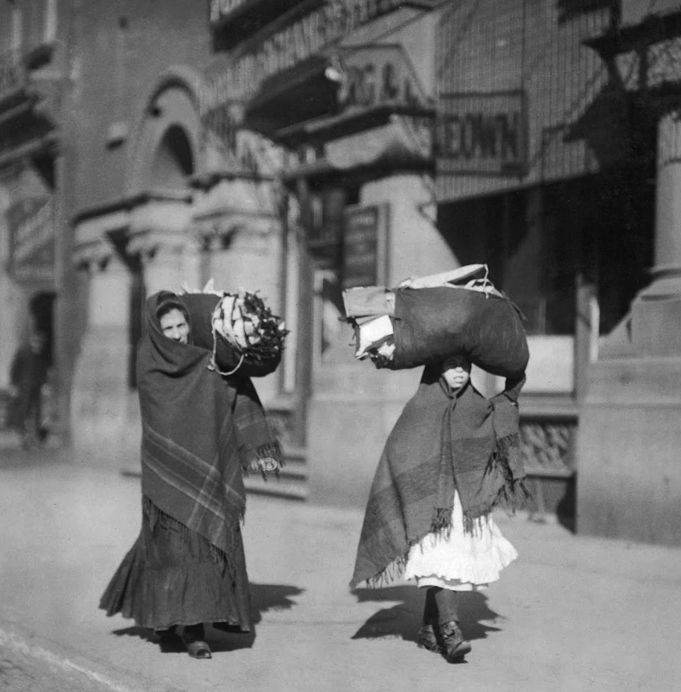
VI. What Was it Like Here for the Immigrants?
Some native-born Americans feared and resented the new immigrants.
Their languages, religions, and customs seemed strange.
Hostility from native-born white Americans towards the new immigrants was known as nativism.
Desperate for jobs, immigrants often accepted lower wages and worse working conditions.

Slide 19
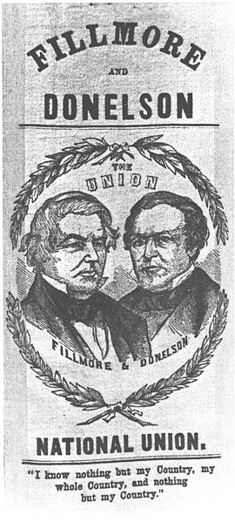
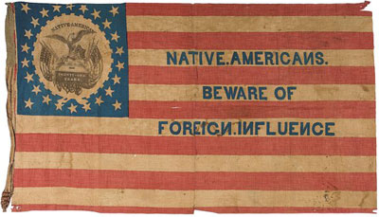
A nativist political group known as the “Know-Nothing Party” emerged, with limits on immigration as its main goal.
The party particularly targeted German and Irish Catholic immigrants, who were often regarded as hostile to Anglo-Saxon Protestant values and were viewed as being controlled by the Pope in Rome.
Notes:
The Know Nothing movement was a nativist American political movement of the 1840s and 1850s. It was empowered by popular fears that the country was being overwhelmed by German and Irish Catholic immigrants, who were often regarded as hostile to Anglo-Saxon Protestant values and controlled by the Pope in Rome. Mainly active from 1854 to 1856, it strove to curb immigration and naturalization, though its efforts met with little success. Membership was limited to Protestant males of British lineage over the age of 21
The origin of the "Know Nothing" term was in the semi-secret organization of the party. When a member was asked about its activities, he was supposed to reply, "I know nothing.“
Also known as the American Party or the American Republican Party.
The platform of the American Party called for, among other things:
Severe limits on immigration, especially from Catholic countries.
Restricting political office to native-born Americans of English and/or Scottish lineage and Protestant persuasion.
Mandating a wait of 21 years before an immigrant could gain citizenship.
Restricting public school teacher positions to Protestants.
Mandating daily Bible readings in public schools.
Restricting the sale of liquor.
Restricting the use of languages other than English.

Slide 20
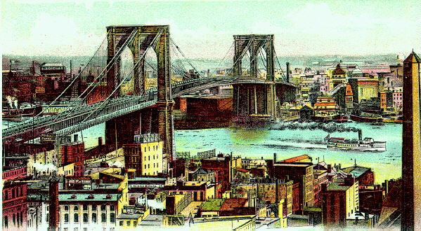
URBANIZATION

Slide 21
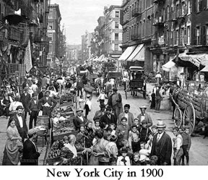
I. Cities Grow
The majority of immigrants settled in the big cities where factory jobs were available. By 1900, 4 out of every 5 people in New York City were immigrants or children of immigrants.
Chicago also grew into one of the largest major cities due to its location and combination of manufacturing, shipping, and railroads.

Slide 22
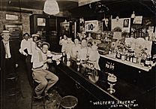
Many immigrants lived in areas with people of similar ethnic background.
Such neighborhoods provided support, but separated the immigrants from the rest of Americans, thus slowing their assimilation into US culture.
Notes:
Polish neighborhood chicago

Slide 23
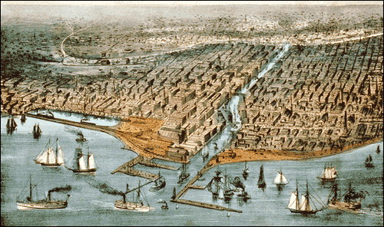
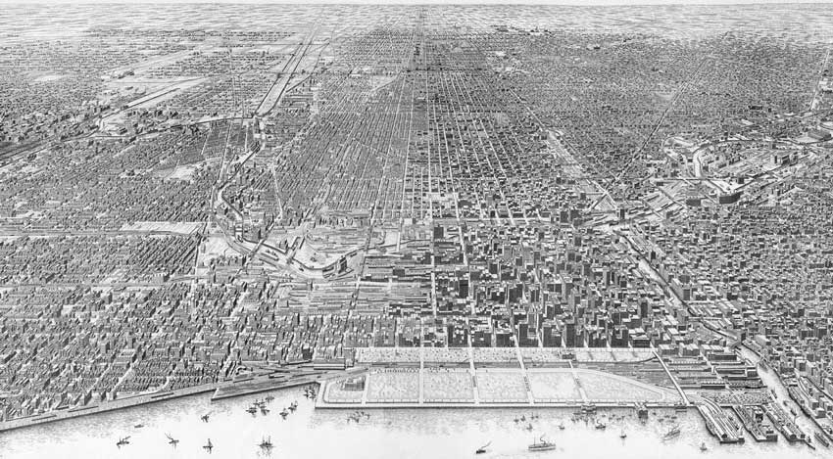
Chicago, 1871
Chicago, 1916

Slide 24
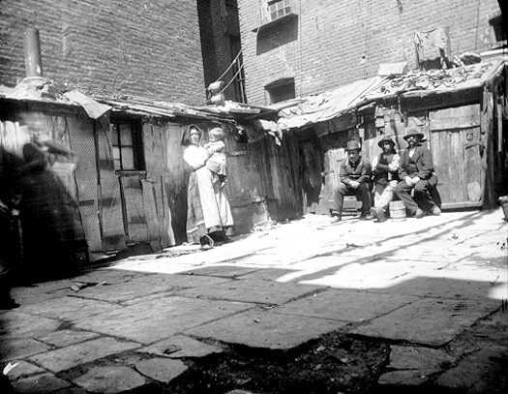
II. Housing the Immigrants
*
Many immigrants lived in crowded tenement buildings.
Families shared living space, and decent lighting and fresh air were scarce.
Tenement Museum
Notes:
crowded tenement buildings (sub-standard multi-family buildings).

Slide 25

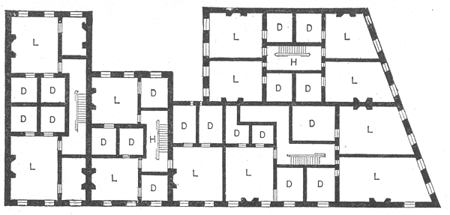
Notes:
Some of you may've seen the movie Gangs of New York, about the horrible life of Irish immigrants in Manhattan's lower East Side before the Civil War. The movie was about how gang warfare was bred in the appalling living conditions of those slums, but it also suggested something of the horror of the living conditions themselves.
Much of that housing could be described by the general term tenement, which meant any multiple family dwelling. After the Civil War, the slum-landlord owners of the tenements had let conditions get bad enough that New York finally undertook reforms.
The result was a more-or-less standard tenement house, and it was a huge improvement. The new regulations had called for things like windows and ventilation shafts. I learned how those would-be model homes were laid out when I thumbed through the 1894 Scribner's Magazine. An article by noted architect Ernest Flagg, The New York Tenement-House Evil and Its Cure, showed standard tenement floor plans, and Flagg began with the words
The greatest evil which ever befell New York City was the division of the blocks into lots of 25x100 feet. Tenements were now designed as modules, each of which occupied one of these lots, edge-to-edge, except for a ten-foot yard in back. A tenement house was a four or five storey row of modules. So let's look at the floor plan in a module:

Slide 26
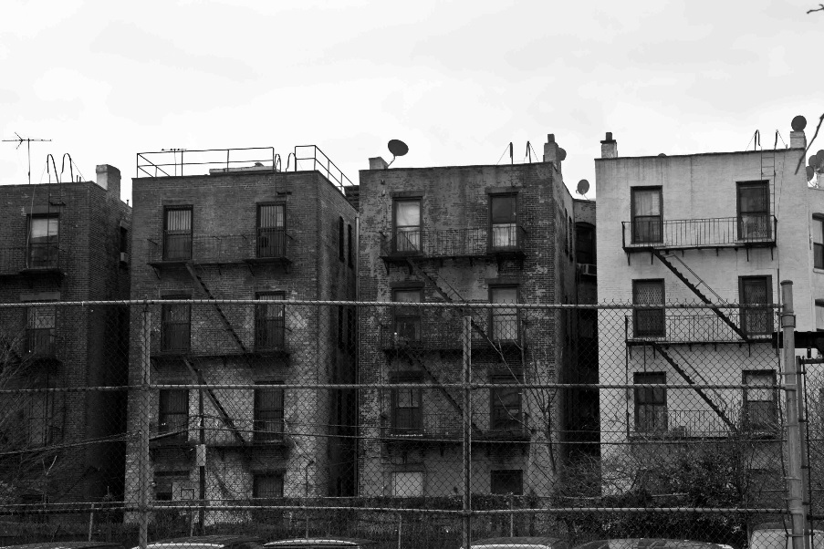
III. Living Conditions
Conditions were uncomfortable, crowded, and dirty.
In New York, 1,231 people lived in only 120 rooms in one part of the city.
In Chicago in one year, over 60% of newborns never reached their first birthdays.
Many babies asphyxiated (suffocated) in their own homes.

Slide 27
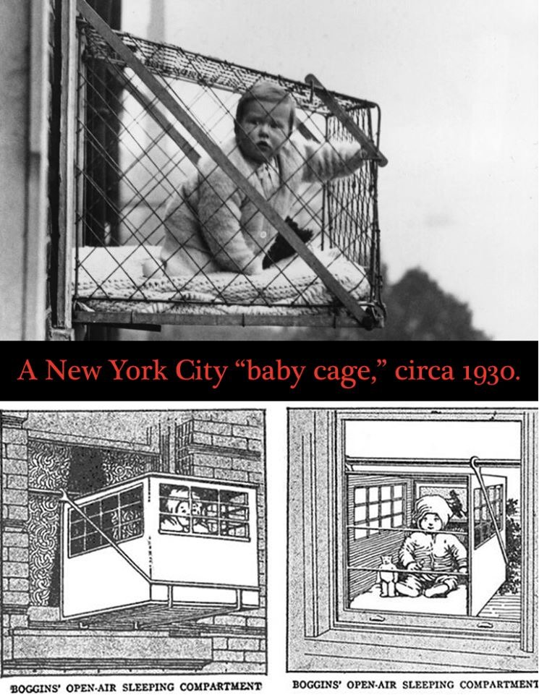

Slide 28
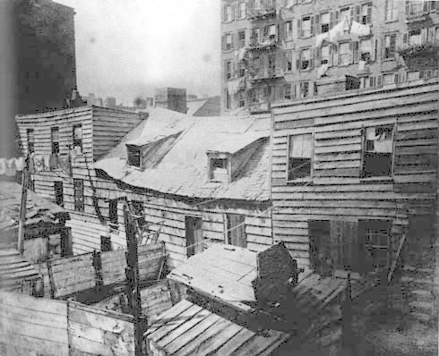
IV. One Man Works for Change
An immigrant himself, Jacob Riis was well known for his photographs documenting the lives of immigrants & the urban poor in his book How the Other Half Lives.
He attempted to alleviate the bad living conditions of poor people by exposing them during public talks.
Notes:
Jacob August Riis was a Danish American social reformer, "muckraking" journalist and social documentary photographer. He is known for using his photographic and journalistic talents to help the impoverished in New York City; those impoverished New Yorkers were the topic of most of his prolific writings and photography. He endorsed the implementation of "model tenements" in New York with the help of humanitarian Lawrence Veiller. Additionally, as one of the most famous proponents of the newly practicable casual photography, he is considered a developer of photography. While living in New York, Riis experienced poverty and became a police reporter writing about the quality of life in the slums. He attempted to alleviate the bad living conditions of poor people by exposing their traditionalism to middle class ridicule.
Show clip from “America the story of US”

Slide 29
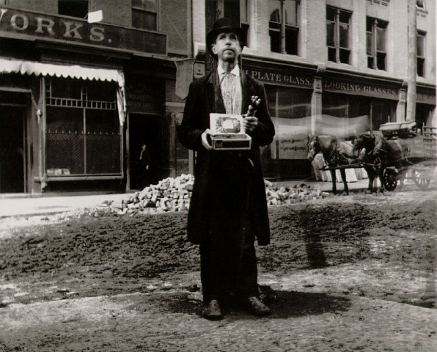
Blind Beggar, 1888

Slide 30
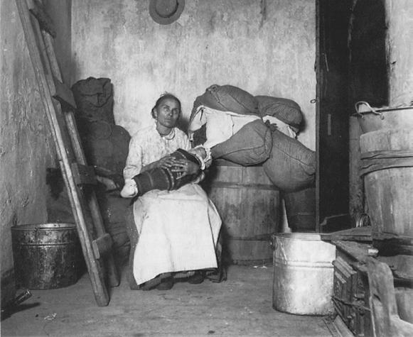
Italian Rag-Picker

Slide 31
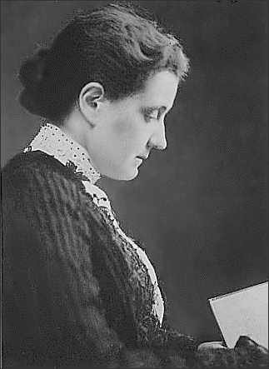
V. More Help for the Immigrants
Jane Addams started a settlement house called Hull House in a Chicago slum neighborhood
A settlement house was an all-purpose community center for poor people living in crowded city neighborhoods
She was an early social reformer
Notes:
Jane Addams reading

Slide 32
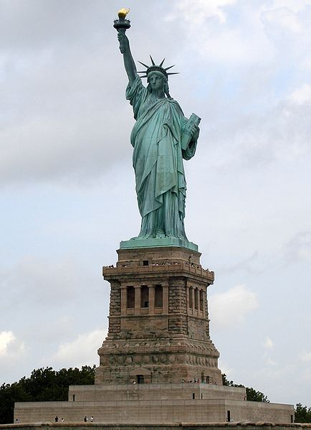

Slide 33
The New Colossus
Not like the brazen giant of Greek fame,
With conquering limbs astride from land to land;
Here at our sea-washed, sunset gates shall stand
A mighty woman with a torch, whose flame
Is the imprisoned lightning, and her name
Mother of Exiles. From her beacon-hand
Glows world-wide welcome; her mild eyes command
The air-bridged harbor that twin cities frame.
"Keep ancient lands, your storied pomp!" cries she
With silent lips. "Give me your tired, your poor,
Your huddled masses yearning to breathe free,
The wretched refuse of your teeming shore.
Send these, the homeless, tempest-tost to me,
I lift my lamp beside the golden door!"

Slide 34
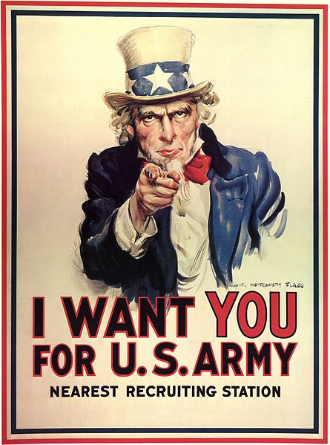
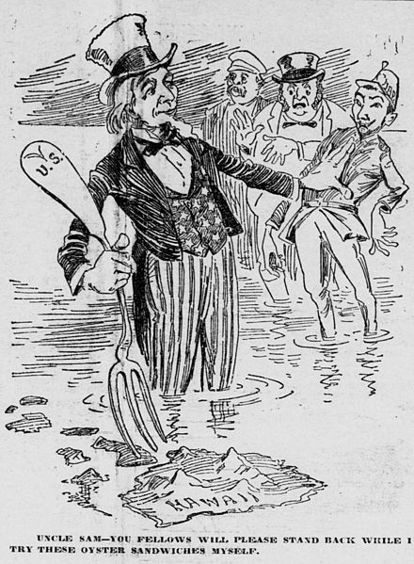

Slide 35
Analyzing Attitudes on Immigration Through Political Cartoons
Working independently, closely examine each of the political cartoons.
Answer the questions that correspond with each cartoon. Show me your completed work, then I will give you a list of concluding questions.
Complete the concluding questions; staple them to the front of the packet, and turn into the tray for a quiz grade.
DO NOT COPY OTHER STUDENTS’ WORK. YOU DO NOT LEARN THAT WAY.

